Slide 1
Building APIs with LoopBack
Raymond Camden

Slide 2
Before we get started

Slide 3

Things you should know (part 1)
Node.js
Kinda
If you "Stack Overflow"-know Node, you're golden
Express
Kinda

Slide 4
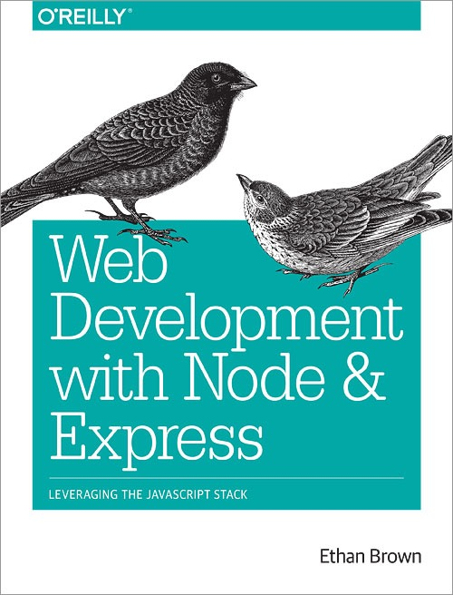
"Web Development with Node & Express"
Ethan Brown
Covers everything (ok, not *everything*)
http://shop.oreilly.com/product/0636920032977.do

Slide 5

Things you should know (part 2)
Captain Crunch's full name is...
Captain Horatio Magellan Crunch
His ship is the...
S.S. Guppy
There have been 26 varieties
https://en.wikipedia.org/wiki/Cap%27n_Crunch#Variations

Slide 6
Things you should install
Node (but if you don't have this already...)
A good editor (hint - Visual Studio Code)
Mongo (totally optional)

Slide 7
Gameplan
30-40 minutes of me talking about LoopBack and showing some examples
Quick Break (5 minutes)
Exercises

Slide 8

Raymond Camden
Developer Advocate for IBM
StrongLoop, Bluemix, Cordova/PhoneGap, Node, and web stuff in general
Blogging at raymondcamden.com
Tweeting at @raymondcamden

Slide 9
Why build APIs?

Slide 10
APIs give you...
A way to share your data or processes with others
A way to provide data for your client-side/mobile/hybrid/TV/etc app

Slide 11


Slide 12
LoopBack
Open source framework designed for APIs
Rapid creation of Models and REST APIs
Simple ORM system for CRUD
Built on Express
Very detailed/configurable security policies
loopback.io

Slide 13
Getting Started

Slide 14
Installation
Requires npm (Node Package Manager)
Install Node.js (nodejs.org)
npm install –g strongloop
CLI: slc

Slide 15
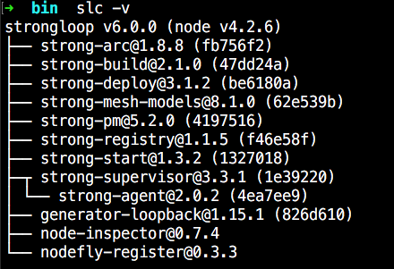

Slide 16
Creating an Application
slc loopback
Follow the prompts
Run the application

Slide 17

Notes:
slc loopback
call it (currentdate)
Show the code - mention Express

Slide 18
LoopBack and APIs
You aren't defining an API
I want to support GET /cats
I want to handle PUT /cats
You are defining data
I work with Cats (they have names and weights)
"Ok, let me handle that for you!"

Slide 19
Models
Models define your API
You describe properties - LoopBack does the rest (get it - "REST"... heh)
Inheritance + Relationships
Out of the box - full CRUD + search

Slide 20
Notes:
slc loopback
call it (currentdate)
Show the code - mention Express

Slide 21
Datasources
Where LoopBack stores crap
Referred to as connectors as well
Cloudant, DB2, Memory, MongoDB, MySQL, Oracle, PostgreSQL, Redis, SQL Server
npm install loopback-connector-mongodb --save
Roll your own

Slide 22
Notes:
slc loopback
call it (currentdate)
Show the code - mention Express

Slide 23
Security

Slide 24

Notes:
out of the box – this is what you get

Slide 25

Notes:
most likely – this ios what you want

Slide 26
Security
Security system models built in
Access Control List
What users can do what
Users can be grouped into Roles
Methods can be grouped into read/write

Slide 27
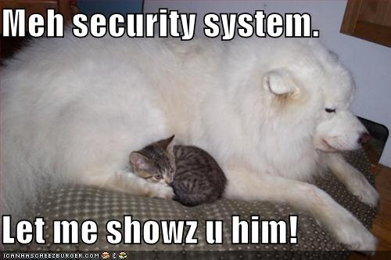

Slide 28
Customizations
Remote Hooks
Operation Hooks
Remote Methods
Crap ton of stuff for Express too

Slide 29
Notes:
slc loopback
call it (currentdate)
Show the code - mention Express

Slide 30
Additional Random Stuff
File Attachments
Models based on APIs (an API for an API)
And more...

Slide 31
Questions?

Slide 32


Slide 33
Exercises - Let's Build an API!

Slide 34
General Plan
A Guestbook
Users can write a note for the site saying hello, I love you, etc.
Ajax based application
Server-side validation
Prevent delete

Slide 35
Exercise 1
Create a LoopBack application (name it whatever)
Run it
Confirm you see the home page and explorer

Slide 36
Exercise 2
Create a Guestbook Model
Properties: Name, Email, Message, Posted

Slide 37
Exercise 3
Add persistance
Either file based or Mongo
npm install loopback-connector-mongodb --save

Slide 38
Exercise 4
Build the front end
GET all posts and render
Form to POST a new post
Notes:
Look for files in middleware

Slide 39
Exercise 5
Sort by newest first
Show a max of 10 items
Reference: https://docs.strongloop.com/display/public/LB/Querying+data
Notes:
http://localhost:3000/api/posts?filter%5Border%5D=created%20desc

Slide 40
Exercise 6
Default created to now()
Two ways:
set the default to a function (defaultFn:"now")
use a remote hook to set it
Notes:
http://localhost:3000/api/posts?filter%5Border%5D=created%20desc

Slide 41
Exercise 7
Sanitize time!
Intercept name and body and strip out HTML
Block 'created'

Slide 42
Remote Hooks
beforeRemote
afterRemote
afterRemoteError

Slide 43
Example
modelName.beforeRemote( methodName, function( ctx, next) {
//stuff here next(); });

Slide 44
Exercise 8
Prevent deletes
A small part of a greater security model

Slide 45
Example
slc loopback:model
Methods: updateAttribures, upsert, destroyById
Reference: https://docs.strongloop.com/display/public/LB/Controlling+data+access

Slide 46
Another Example
Product.disableRemoteMethod('create', true);
https://docs.strongloop.com/display/public/LB/Exposing+models+over+REST#ExposingmodelsoverREST-Read-Onlyendpointsexample

